Slide 1
Academic culture shock: Promoting first generation student success through psychological wellbeing Rosa Moreno-Alcaraz, Ph.D.
Notes:
Introduce self- CSULB, Psychologist, CAPS
I’m a first generation college student – parents education, value of education
I work every day with student adjustment issues and with the most vulnerable of our student population
I believe that the university has a responsibility to the development of the whole person and that students and those who work with them would benefit from understanding the following topics

Slide 2
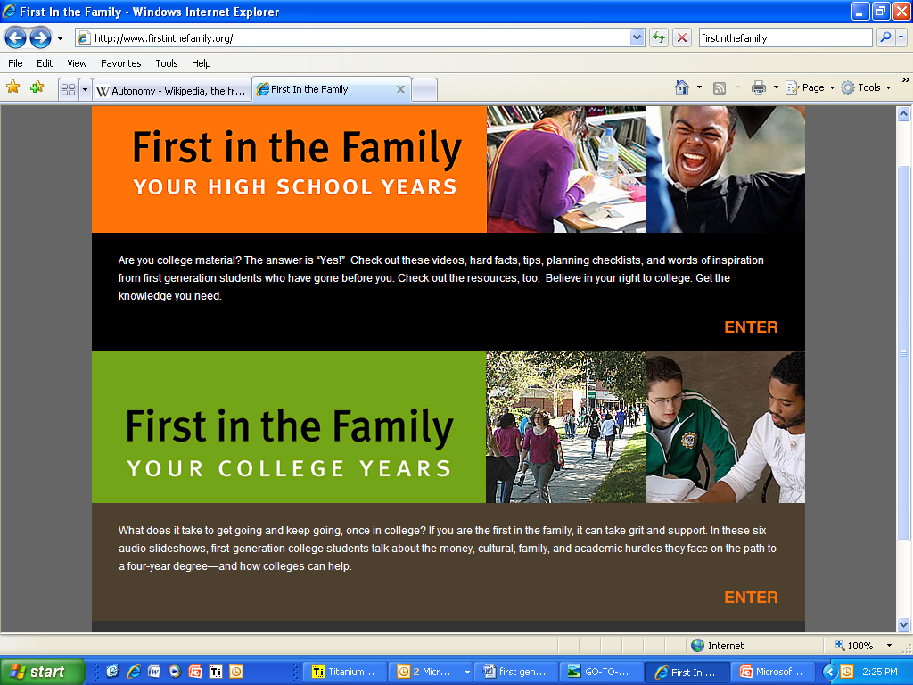
http://www.firstinthefamily.org/
Notes:
This is a website with some good information video clips and such that can be helpful for you and students
There is also a book called First in the family that can be helpful

Slide 3
Primary Developmental Tasks
Separation or differentiation
Identity Formation
Intimacy
Notes:
If we are looking at psychological wellbeing it’s important to understand a college student’s primary developmental tasks
For every student these task are influenced by college environment, class material, organizations, their level of independence, culture, gender, class, LGBT and other aspects of their identity.

Slide 4
Separation
Differentiation from parents, home and high school friends
Gradual Process
Support continues to be necessary
Notes:
We will come back to this to see how 1st gen students are particularly challenged by this task
All students begin to take responsibility for daily tasks, they may live away from home for 1st time or begin to spend less time in the home, students begin to separate from family and are not so dependant on them
Those who do not separate well do not acquire the abilities they will need in the future to become independent adults in society it is a gradual process
Gradual process- financial and emotional support are still necessary
a process for both the students and their parents- students are trying to leave and parents are trying to let go
Their needs may conflict when students is trying to pull away and parents want to keep them there- I see this a lot with Latina/o students

Slide 5
Identity formation
Who am I?
Career confusion, political and religious values
Choices help them take responsibility and develop self-confidence
Identity development
Notes:
Childhood identity, basic aptitude and abilities, social opportunities all contribute to the formation of their identity
Children as they grow up have a sense of who they are but when they become college students they make important decisions that contribute to their identity
Identity development- students are exploring various aspects of their identity such as ethnicity, class, gender, sexual orientation and religion, the are being challenged by and hopefully better understanding and valuing diversity. They are realizing that their cultural background and family dynamics have an impact on who they are.

Slide 6
Intimacy
Increased need for intimacy in friendships & Romantic Relationships
May experience 1st significant Break-up
Notes:
Less need for intimacy with the family
Looking for others to share a bond with- they look for friends they can share meaningful experiences with
difficulties occur when they isolate themselves or are overly dependent on family or they can’t commit to relationships
1st significant break up in a meaningful relationship- this can be one of the most stressful experiences of their college years and can escalate into an academic crisis.
All of these are transitions and adjustments they are experiencing which will have an impact on their well being.

Slide 7
Predictable developmental crises
differentiation from parents, career confusion, romantic relationships, being evaluated, transitions, adjustments
Notes:
If any of these is experienced when they are feeling particularly vulnerable or are fragile this may lead them to experience a predictable developmental crisis
the experience of a crisis is overwhelming and distressing but it may be reframed to be seen as an opportunity for change

Slide 8
1st generation lens
Tasks
Separation
Identity formation
Achieving intimacy
Aspects of self
Independence
Class
Culture
Gender
Sexual orientation
Alienation
Notes:
So lets add to the developmental tasks some of the aspects that are 1st generation college students bring
if we think of a Latina, 18 yr old who lives with her parents whose H.S. friends did not go to college and who just started dating; issues of separation and autonomy of finding her own voice and being independent may be particularly challenging on top of this she feels alienated at the university and spends breaks in between classes in her car feeling alone and alienated and her classes are challenging her religious views, she is trying to find her way but feeling very confused.
Asian American female whose parents drop her off and pick her up from school, parents have chosen her major and don’t think she should get involved in orgs because it is a waste of time, she also works part time to help out at home, she is taking a women’s and their bodies class and is starting to wonder about her sexual orientation
Cultural expectations that we have when it comes to gender regarding autonomy, sexuality, financial obligations

Slide 9
Mental Health & Wellbeing
Imposter phenomenon
Self esteem
Substance abuse
Depression & Anxiety
Suicidal ideation
Sexual assault/child abuse
Notes:
I wanted to touch on some of the mental health issues that I see in all students and which also impact 1sts
This phenomenon is well documented and often seen with women of color and I would say it applies to people of color in general- the student does not internalize their success they feel that they have fooled everyone and experiences anxiety and guilt
Issues of self esteem come up often- students feeling not good enough
Substance abuse and use of the student and ACA issues in the family
Depression- seeing the world and themselves through a negative lens, Anxiety- fears that paralyze them
Suicidal ideation- increased hospitalizations- Latinas 1 in 5 have thought about it
Sexual assault and sexual abuse- devastating and may result in many negative beliefs of self and the world

Slide 10
Referral to CAPS
When you have a connection with a student
They have confided in you/vulnerable
Normalize talking to someone and obtaining clarity and guidance
Plant the seed
Motivation has to come from them
Notes:
This is kind of out of sequence and may not seem relevant but I would be negligent as a psychologist to mention mental health and wellbeing without talking about referrals to CAPS

Slide 11
Academic culture shock
2 worlds collide
1st gen students have one foot in the academy and one foot at home
Notes:
When I think of first gen I’m thinking working class and people of color
With one foot in each place they are particularly vulnerable because if they trip they are on a slippery slope

Slide 12
Two worlds collide
1st Generation Student
The Academy
Relationships with others
Financial survival
Survival of the group
Time is flexible and secondary to “felt need” or relationship responsibility
Order
Structure
Focus on time
Hierarchy
Independence/autonomy
Notes:
Students value connection if they don’t find it they are vulnerable and may leave because their friends may be going down another path that is more familiar and accessible to them
Most of them have to work some of them work 40 hrs a week and their families and communities may value work over being part of an org or spending time in the library
Survival of the group-Group cohesion- family obligations are important- group need outweighs the individual’s need
“felt need” what do I want to do or feel like doing – they won’t be coming during your office hours but when they feel the need.
Relationship responsibility- feel more responsible for maintaining connections than for meeting the expectations of the academy
Students are vulnerable for slipping down the slope if they don’t feel connected, if they feel like having a foot in two worlds is too much they feel pulled by those that do not follow the path that they are on.
This is a process of acculturation- learning to live in these two worlds and making it work for you
I often talk to Latina students about the schizophrenic process of having different cultural/gender expectations in both of these worlds

Slide 13
What can be done
Build relationship
Help with interpersonal and professional skills
Validate and normalize their experience
Recognize them as the strivers that they are
Speak to the part of them that wants to be here
Know that they want your approval
Help them move from Academic Culture shock to Academic Ownership
Notes:
Building a relationship-We may need to adjust to their “felt need” at the beginning and then when they trust us help them polish their interpersonal and professional skills
We can help facilitate the development of clearer communication skills, social skills and professional identity such as helping them learn how to talk to professors, contribute to classroom discussions and network in their field
Validate & Normalize- acknowledging their experience, verbalize the difficulty of maintaining focus on academics while feeling pulled in various directions
They are strivers- they have taken a different path- by definition, they are the first they may have gone against the current and may still be swimming up stream
Because they are striving to attain a degree there is certainly a part of them that wants to be here when they are down and out speak to that part
If they seek out a relationship with you, feel honored by this and realize that they look up to you and want your approval
Moving from academic culture shock to academic ownership- actively engaging students to help them own their university experience, need to make a concerted effort to reduce alienation and disengagement of at risk students

Slide 14
The only factor becoming scarce in a world of abundance is human attention
-Kevin Kelly
Notes:
(Read quote)
I wanted to end with a quote and I think it is a testament to your character that you value meeting students where they are at, that you strive to understand them and that you are seeking ways of attending to their needs

